Slide 1
Sharda University Unit 2 Planning By Neeti Saxena Assistant Professor

Slide 2
PLANNING
“Planning includes all the activities that lead to the definition of objectives and to the determination of appropriate courses of action to achieve those objectives”.
Planning involves defining the organization’s goals, establishing an overall strategy for achieving those goals and developing plans for organizational work activities.
It’s concerned with both ends (what’s to be done) and means (how it’s to be done).
They determine resource allocations (distribution), timetables and other necessary actions to accomplish the goals

Slide 3
Nature of Planning
It is the beginning of the process of management.
Intellectual process- think before acting.
Decision making is integral part of planning.
Continuous process.
Flexible.
All pervasive function- applicable across the different levels of management.

Slide 4
Importance of planning
Minimizes risk and uncertainty.
Leads to success.
Focuses attention on organisation’s goals.
Facilitates control.

Slide 5
TYPES OF PLANNING- contd….
SINGLE USE PLANS
Have a clear time frame for their usefulness.
STANDING PLANS
Have ongoing meaning and applications for an organization.
Includes detailed goals and objectives concerning quality, primary markets, rollout schedule, etc.

Slide 6
TYPES OF PLANNING
STRATEGIC PLANNING
Comprehensive, long term and relatively general
States the organization’s mission and may describe a set of goals to move a company into future
OPERATIONAL PLANNING
Focused, short term and specific
Requires efficient, cost effective application of resources to solving problems and meeting objectives
Focus on broad, enduring issues for ensuring a firm’s effectiveness over a long period of time
Translates the broad concepts of the strategic plan into clear numbers, specific steps and measurable objectives for the short term
TACTICAL PLANNING
Falls between strategic and operational planning
More specific than strategic planning
Deal more with issues of efficiency than with long term effectiveness

Slide 7
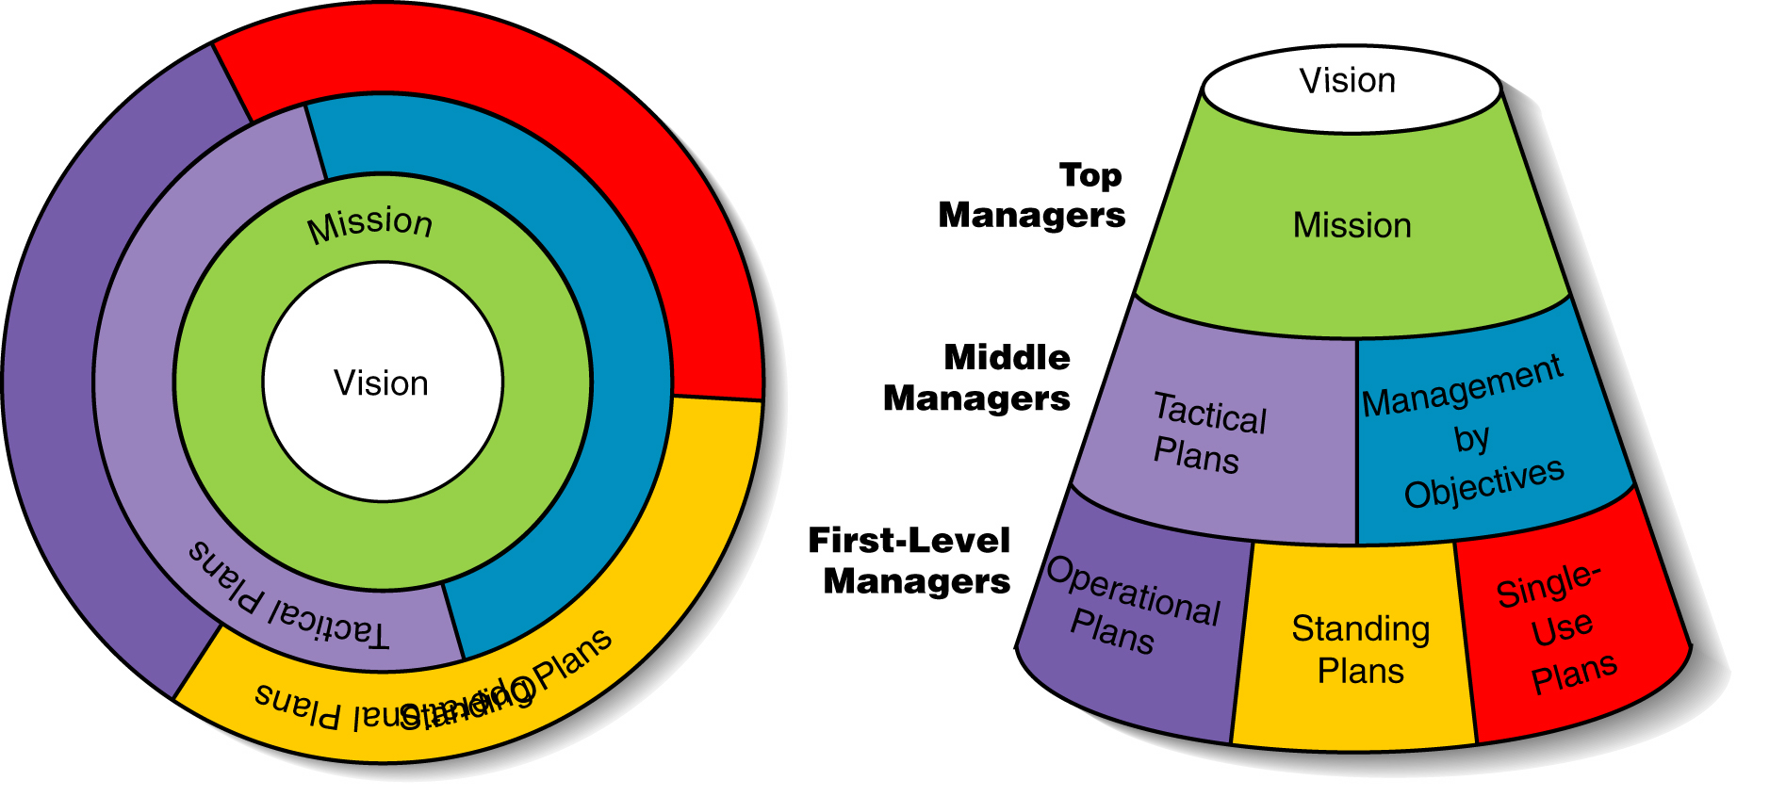
HIERARCHIES OF PLANNING

Slide 8
STRATEGIC PLANNING- INTRODUCTION
STRATEGY: the larger vision that guides the activities of managers and other employees in an organization.
It is a process that results in an outcome, which is the basis for organizational decisions and actions.
STRATEGIC THINKING: The determination of the basic long term goals and objectives of an enterprise and the adoption of courses of action and the allocation of resources necessary for carrying out these goals.

Slide 9
STRATEGIC PLANNING
Strategic planning is conducted at a higher level of an organization than tactical planning and is broad in scope..
Usually involves choice among a range of alternatives.
Uncertainty is high in strategic planning.

Slide 10
STRATEGIC PLANNING- contd….
It requires large amounts of information and tends to encompass the entire scope of activity of an organization.
It constitutes the point of reference or framework for other planning, especially tactical planning.
Involves only the senior managers of an organization. .
Strategic planning is usually conducted from the perspective of the organization as a whole.

Slide 11
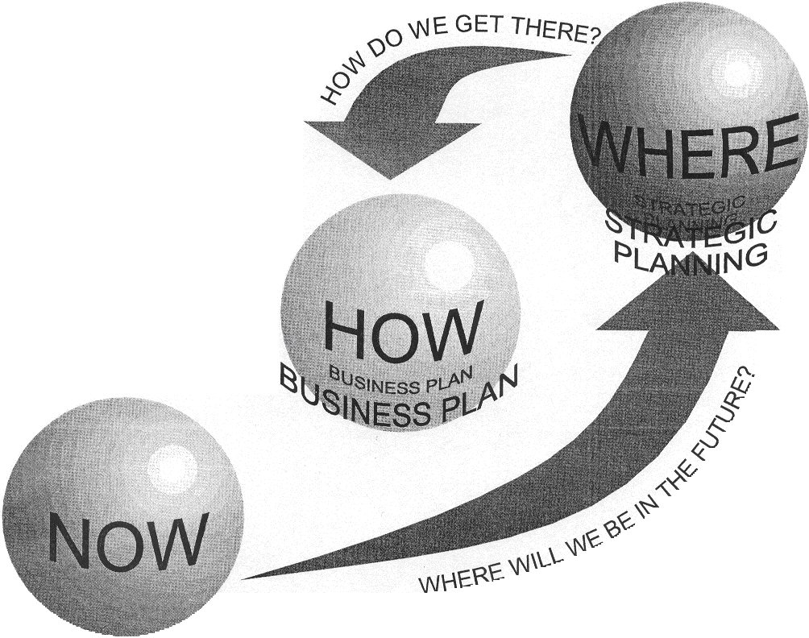

Slide 12
STRATEGIC PLANNING
STRATEGIC PLANNING is a process that involves:
review of market conditions
customer needs
competitive strengths and weaknesses
sociopolitical, legal and economic
conditions
technological developments
availability of resources that lead to the specific opportunities or threats facing the organization.
It involves taking information from the environment and deciding upon the organizational mission and upon objectives, strategies and a strategic architecture.

Slide 13
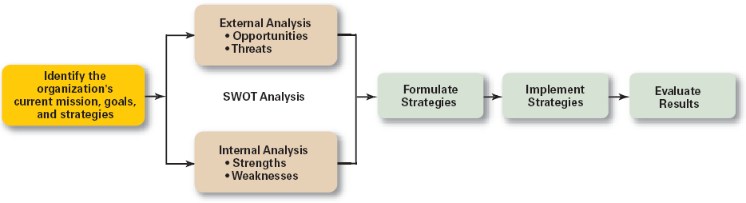
STRATEGIC PLANNING PROCESS

Slide 14

WHY IS STRATEGIC PLANNING IMPORTANT?
It results in higher organizational performance.
It requires that managers examine and adapt to business environment changes.
It coordinates diverse organizational units, helping them focus on organizational goals.
It is very much involved in the managerial decision-making process.

Slide 15
TYPES OF ORGANIZATIONAL STRATEGIES
Corporate Strategy
Top management’s overall plan
for the entire organization and its strategic business units.
Growth Strategy
Seeking to increase the organization’s business by expansion into new products and markets.
Business (or Competitive) Strategy
A strategy focused on how an organization should compete in each of its SBUs (strategic business units).

Slide 16
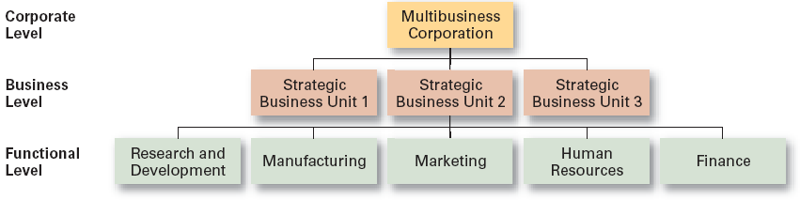
LEVELS OF ORGANIZATIONAL STRATEGY

Slide 17

TACTICAL PLANNING
Tactical plans have shorter time frames and narrower scopes than strategic plans.
It provides the specific ideas for implementing the strategic plan.
It is the process of making detailed decisions about what to do, who will do it, and how to do it.
Tactical planning is often done on a fixed schedule.
The problems confronted in tactical planning tend to be of a repetitive nature.
It usually has a short time horizon.
Tactical planning concentrates on a narrow operational planning task.
Tactical planning is usually done from a functional point of view.

Slide 18
OPERATIONAL PLANNING
Operational planning covers a broad scope related to anticipating and scheduling day-to-day activities in a wide variety of organizational settings.
The time frame for an operational plan is usually 1 year or less. It is a plan for a connected series of activities to achieve senior management's objectives within a given time frame.
A business operational plan contains:
business process changes
major activities in functional areas like marketing and finance
any organizational culture issues
budget plans
logistics plans for delivering products or services
human resource and managerial policy decisions critical to running the business.

Slide 19
ELEMENTS OF PLANNING
OBJECTIVES
ACTIONS
RESOURCES
IMPLEMENTATION
Integral to plans because they specify future conditions
Are the specified, preferred means to achieve the objectives
Resources required to convert plan into action
Involves the assignment and direction of personnel to carry out the plan

Slide 20
PLANNING PROCESS
Review the organization’s mission, the purpose of an organization
Evaluate available resources
Establishing verifiable goals individually or with input from others
Evaluating and selecting a course of action.
communicate the plan to all who need to know
Measuring and controlling the progress.
Review results and whether goals are being met

Slide 21
LIMITATIONS OF PLANNING

Slide 22
CONTEMPORARY ISSUES IN PLANNING
Criticisms of Planning
Planning may create rigidity: In achieving specific goals, managers may not be able to cope with the changing environment.
Plans cannot be developed for dynamic environments: These conditions may mean not being tied to formal plans.
Formal plans cannot replace intuition and creativity: They may reduce intuition to programmed routine.
Planning focuses managers’ attention on today’s competition not tomorrow’s survival: They focus on existing business opportunities, not creativity.
Formal planning reinforces today’s success, which may lead to tomorrow’s failure: Successful plans provide a false sense of security than is warranted (justified, called for).

Slide 23
Managers face two type of problems
1-Identifing the factor which are relevant for planning.
2-The method through which the likely future behavior of these factor can be predicted.

Slide 24
Solution to the problem is premising and forecasting

Slide 25
Premising & Forecasting
Identifying the factor which are relevant for planning. This is known as PREMISING
The method through which the likely future behaviour of these factor can be predicted.
This is known as FORECASTING

Slide 26
PLANNING PREMISSES
Planning Premises Include Both Anticipated And Known Condition Under Which Plans Are Formulated

Slide 27
In order to analyze the factors that affect developing the premises, two factors have to be taken into account:
I. The probability of impact of factors:
If represents whether the factors under study affect or do not affect the planning premises. This probability can be high, medium or low.
II. The degree of impact of factors:
Given the factors which have the probability of developing planning premises, it represents the degree to which these factors affect the planning premises. This can also be high, medium or low.

Slide 28
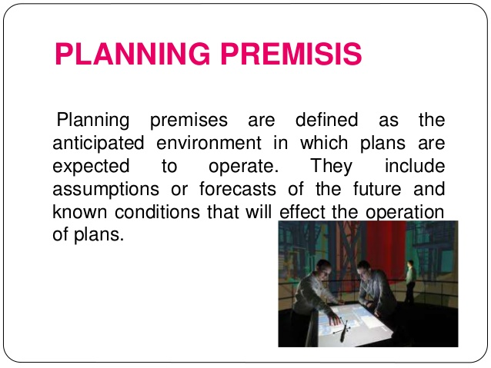

Slide 29
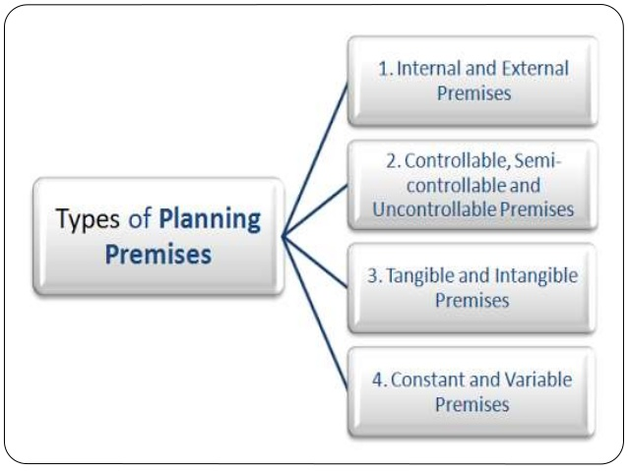

Slide 30
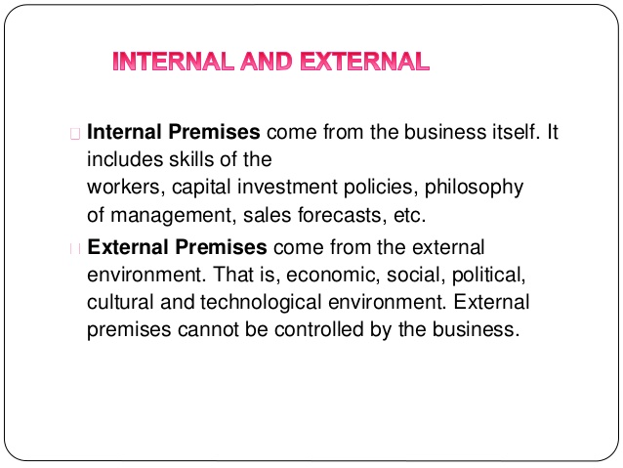

Slide 31
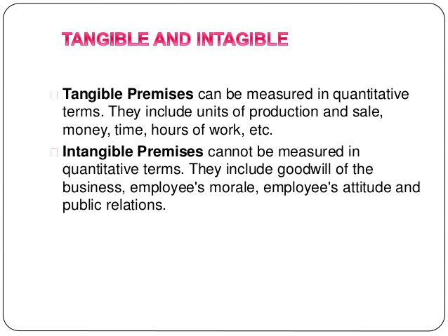

Slide 32
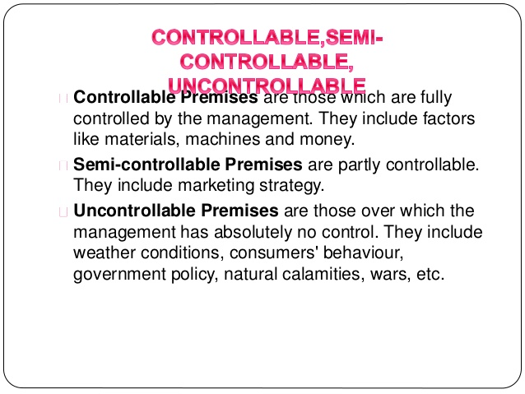

Slide 33
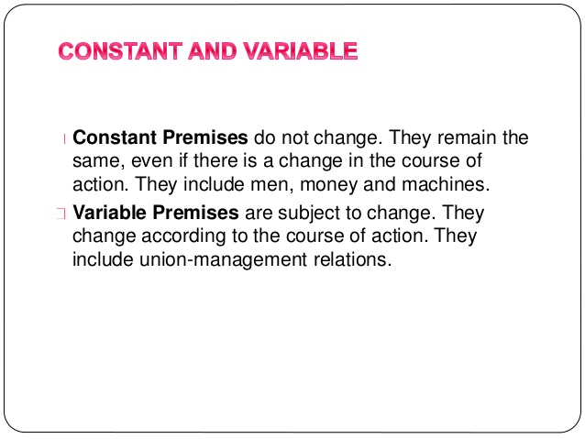

Slide 34
Importance of Planning Premises
Well organised planning can be done.
Risk of uncertainty reduces.
Co – ordination becomes effective.

Slide 35
MAKING PREMISING EFFECTIVE
Since information is the basic source on which planning premises are developed, correct and relevant information lead to better planning premises

Slide 36
FORECASTING

Slide 37
FORECASTING
Forecasting is a process of predicting or estimating the future based on past and present data.
Forecasting provides information about the potential future events and their consequences for the organisation.
It may not reduce the complications and uncertainty of the future.
However, it increases the confidence of the management to make important decisions.

Slide 38
FEATURES OF FORECASTING
Forecasting relates to future events .This is needed for planning process because it devises future course of action.
Forecasting defines the probability of happening of future events .Therefore, happening of future events can be precise only to a certain extent.
Forecasting is made by analysing the past and present relevant events,that is,taking those factors which are relevant for the functioning of an organisation.
The analysis of various factors may require the use of various statistical tools and techniques. However, personal observations can also help in the process.

Slide 39
Importance of forecasting
Helps in better planning
Organisation can anticipate risk and opportunity
Leads to organisation success
Helps in prior preparation

Slide 40
LIMITATIONS OF FORECASTING
Based on assumptions:
Not absolute truth:
Time and cost factor:
Forecasting is mere based on assumption . It suggests that if an event has happened in past , it is probable to happen in future also.
Forecasts are not always true, they merely indicate the trend of future happenings . This is so because the factors which are taken are affected by human factor, which is highly unpredictable.
Time and cost factor is also an important aspect of forecasting . Time and cost factor suggest the degree to which an organisation will go for formal forecasting

Slide 41
STEPS IN FORECASTING
Developing Groundwork for Forecasting.
Estimating Future Business.
Comparing Actual and Projected Result.
Refining the Forecasting Process.

Slide 42
DEVELOPING GROUNDWORK FOR FORECASTING
To develop groundwork for forecasting which involves understanding of why changes are likely at macro and micro levels.
It involves taking past records as basis which might be available internally if proper information system has been developed.
However, a mechanical or mathematical forecast based on past data may not be worthwhile in the fast changing environment.
It is done because many factors not existing in past may exist in future, or there may be a divergence due to externals factors.

Slide 43
ESTIMATING FUTURE BUSINESS
Based on past data and identification of events that are likely to affect the future behaviour of the business.
A trend is projected after a step-by-step procedure in which a relevant information is put for close scrutiny and analysis.
The business trend which emerges out of analysis will suggest the likely behaviour which may or may not corresponds with actuals.
Ex- Government of India prepares its plans, it projects various outcomes at the end of the plan , however we often find that many outcomes do not match like GDP or export or import but many remains constant like the fiscal target.

Slide 44
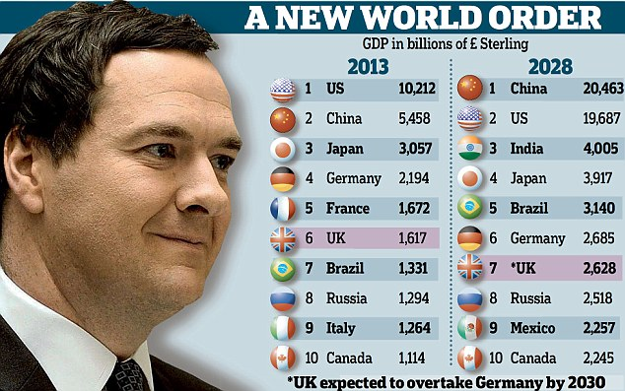
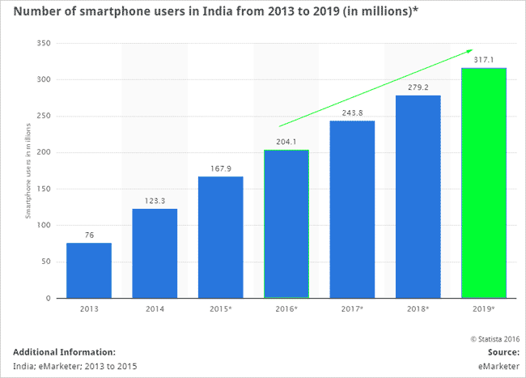

Slide 45
COMPARING ACTUAL AND PROJECTED RESULT
Since there is likelihood of deviation between actual and projected results.
Provisions should be made to identify the deviation as quickly as possible so that necessary changes are incorporated in plans.
Many companies prepare plans on the basis of certain forecasts but either they modify their plans or abandon these midway because of changed environment.
Ex- Many of Indian IT services companies who use about 80% of H1-B visas plunged by upto 4% with TCS by 4.5% ,WIPRO 1.6%, INFOSYS 2% have seen a drop in their stocks after the curb on H1-B visas by the trump administration.

Slide 46
REFINING THE FORECASTING PROCESS
The above three steps complete a cycle of forecasting
However forecasting ,being a continuous process and not one-shot action, is performed continuously with each time. There may be refinement in the forecasting process.
These above steps help the managers to gain proficiency in making dependable forecasts as the time advances :they are able to refine ,sharpen and adjust the forecasting techniques to meet the changing needs of their business.
A lot experience is required to interpret the present situation for the benefit of future.

Slide 47
TECHNIQUES OF FORECASTING
Historical Analogy Method
Survey Method
Opinion Poll
Business Barometers
Time series Analysis
Input-Output Analysis
Econometric Models

Slide 48
HISTORICAL ANALOGY METHOD
Under this method, forecast in regard to a particular phenomenon based on some analogous conditions in the past.
This method is based on the stages of economic development as suggested by Rostow.
According to him, an economy has to be passed through certain stages before the stages of take-off and later of high mass consumption.
Since this is true for all economy, the situation of a country can be forecasted by making comparison with the advanced countries at a particular stage through which the country is presently passing.
SURVEY METHOD
Field survey can be conducted to gather information on the intensions of the concerned people
Information may be collected through survey about the likely expenditures of consumers on various items
Both qualitative and quantitative information may be collected.

Slide 49
OPINION POLL
Opinion poll is conducted to assess the opinion of the knowledgeable person and expert in the field whose views carry a lot of weight.
The opinion of technical expert is helpful in estimating the life of technology.
Ex:- Opinion polls are very popular to predict the result of elections popularly known as Exit Polls.
INPUT-OUTPUT ANALYSIS
Under this method ,a forecast is based on the given input if relationship between input and output is known
Similarly the input requirement can be forecasted by the final output.
This is also known as end-use technique.
The very basis of this technique is that various sectors of economy are interrelated and such relationships are well established.
For ex:- the coal requirement of a country can be predicted on the basis of its usage rate in various sectors, say industry, transport, household etc,.

Slide 50
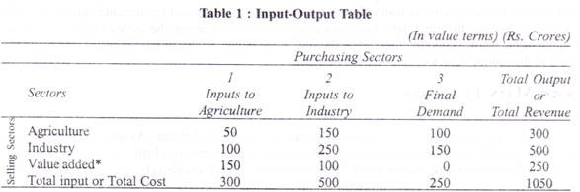
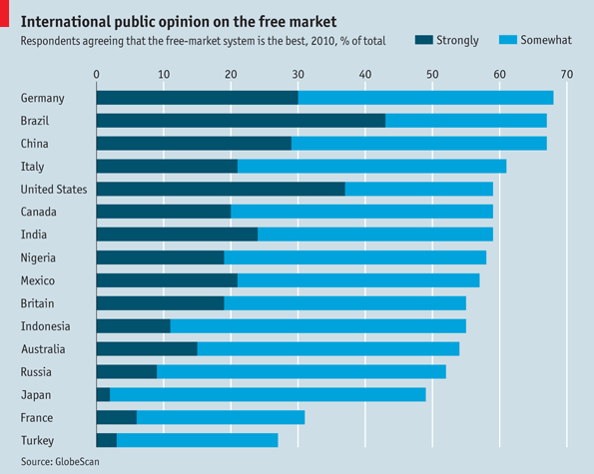

Slide 51
BUSINESS BAROMETERS
Index numbers are used to measure the state of economy between two or more periods.
These index numbers are the device to study the trends, seasonal fluctuations, cyclic movements and irregular fluctuations.
For ex:- a rise in the rate of investment now may herald an upswing in the economy and may reflect higher income and employment after some time. Again an upswing in economic activity may lead to higher personal income and expenditure after lag of some period.
These lag may be difficult to predict precisely but they give some advance signals for likely changes in future.
For example, the monthly unemployment rate and inflation data are announced by the Department of Labor, while the quarterly gross domestic product (GDP) report is issued by the Department of Commerce. These barometers provide a general accounting of the health of the economy at the macro level using massive amounts of data collected across the country.

Slide 52
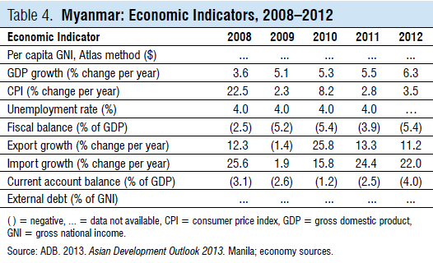
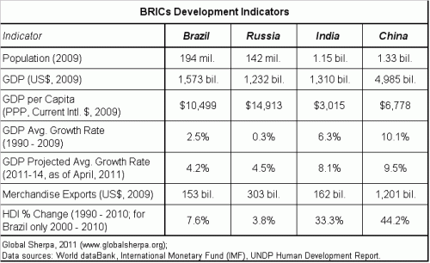

Slide 53
TIME SERIES ANALYSIS
Time series analysis involves decomposition of historical series into its various components viz. trend, seasonal variations, cyclical variations and random variations.
Time series also uses index numbers but it is different from barometric technique.
In barometric technique ,the future is predicted from the indicating series which serve as barometers of economic change.
Whereas in this, the future is taken as some sort of an extension of the past.
When the various components of a time series are separated, the variation of a particular phenomenon, the subject under study, say price can be known over a period of time and projections can be made about future.
A trend can be known over the period of time which may be true for future also.

Slide 54
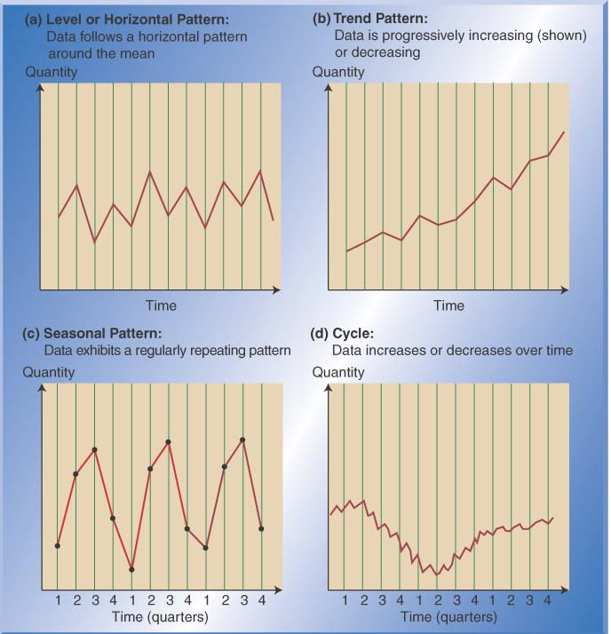

Slide 55
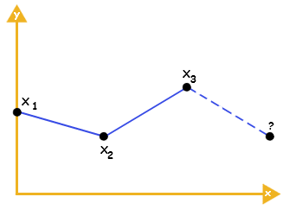
EXTRAPOLATION
Extrapolation is also based on time series because it refers on the behaviours of a series in the past and projects the same trend in future.
This method does not isolate the effects of various factors influencing a problem under study but takes into account the totality of their effects and assumes that the effect of these factor is of a stable and constant pattern.
Since the projection of future is based on fact , it is essential that the growth curve of a series is chosen after a careful study of its past behaviour.
Extrapolation is the process of predicting information about a point outside a curve when few points on the curve are given
In the graph below, the three point x1,x2 and x3are given the
Value of point x4 is extrapolated.

Slide 56
ECONOMETRIC MODEL
The word is made up of “econo” and “”metric” thereby referring to the science of economic measurement.
In this method mathematical models are used to express relationship among variables. These models take the form of a set of simultaneous equations.
The constants in these equation are arrived at by a study of time series and since the variables affecting a business phenomenon are many, a large number of equations may have to be formed to arrive at a particular econometric model.
A simple example of an econometric model is one that assumes that monthly spending by consumers is linearly dependent on consumers' income in the previous month. Then the model will consist of the equation
C_{t} = a + b Y_{t-1} + e_{t}
where C_{t} is consumer spending in month t, Y_{t-1} is income during the previous month, and e_{t} is an error term measuring the extent to which the model cannot fully explain consumption. Then one objective of the econometrician is to obtain estimates of the parameters a and b; these estimated parameter values, when used in the model's equation, enable predictions for future values of consumption to be made contingent on the prior month's income.

